Slide 1

Athletic Office Guidelines and Procedures
VP of Athletics, H&PE, Music & Activities
Frank Torcasio

Slide 2
Triton Athletic Department
VP/Athletics- Mr. Keith Williams
Asst. Athletic Director: Holly O’Donnell
Athletic Secretary: Jeannine Esposito
Athletic Trainer: Rachel Pantaleo
Highland Athletic Department
VP Athletics, H&PE, Music & Activities: Mr. Mike Berger
Asst. Athletic Director: Mr. Patrick Murray
VP Secretary: Jessica Onorato
Athletic Trainer: Athena DeAngelis
Timber Creek Athletic Department
VP Athletics, H&PE, Music & Activities- Mr. Frank Torcasio
Asst. Athletic Director: Dina Tomczak
VP Secretary: Sandy Moretti
Athletic Trainer: Dom Acchitelli

Slide 3
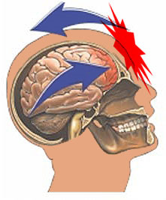
Concussions

Slide 4
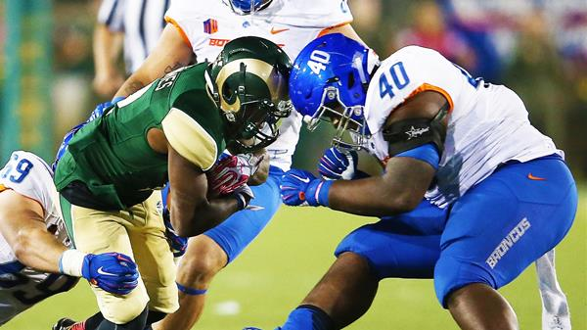
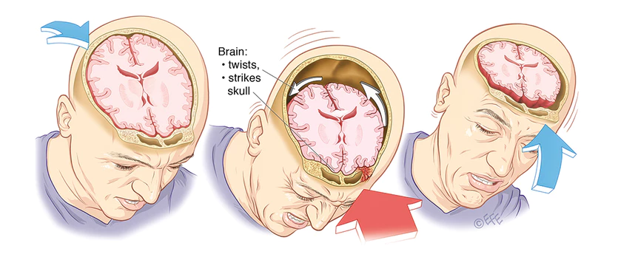
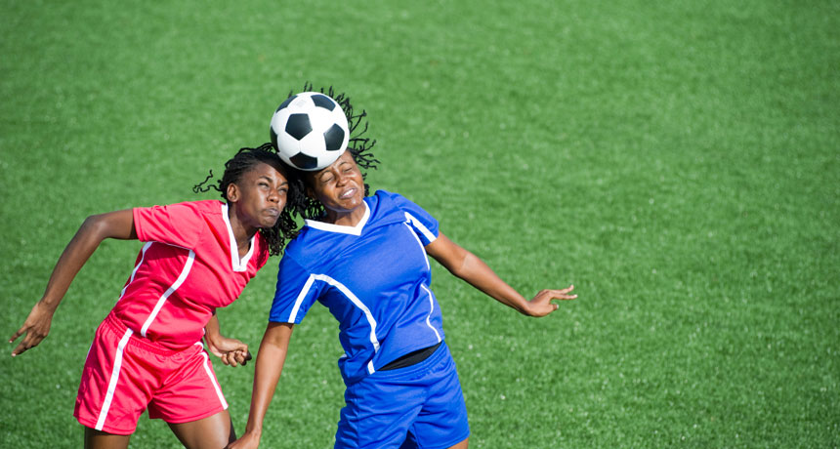
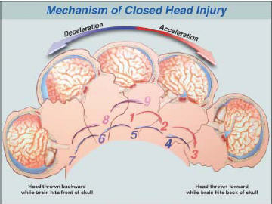
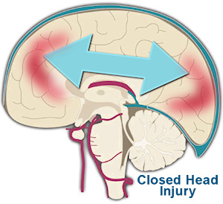
How does a concussion happen?
Contact vs. Inertia
Notes:
Either way they both involve sudden changes in momentum, where the brain smashes against the inside of the skull. This can take any amount of force.

Slide 5
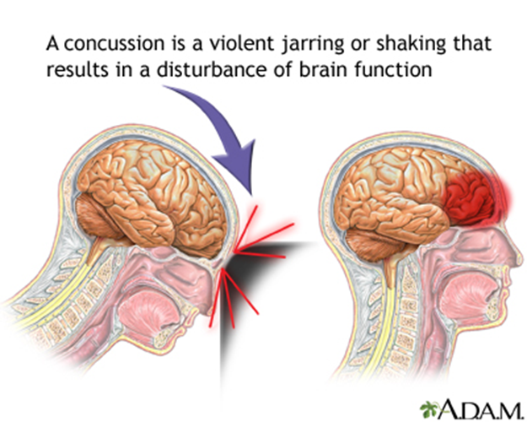
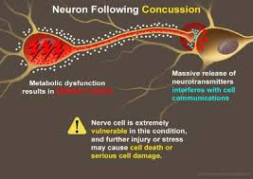
What happens
Neurons that communicate the messages sent in your brain are damaged.
They struggle to communicate properly.
They are extremely vulnerable in this state.
If a second impact were to occur while the neuron is in this state the cell can become permanently damaged or die.
Energy Crisis

Slide 6
Second Impact Syndrome
Second Impact Syndrome can happen, minutes, days, or weeks after the initial concussion occurs.
When a concussion has not fully healed, the athlete is susceptible to SIS.
The brain experiences swelling that further damages the neurons.
SIS leads to permanent brain damage and can be fatal.
This is the reason we take concussions so seriously.

Slide 7
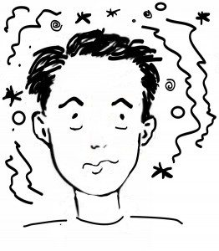
Symptoms of a Concussion
Headache
Nausea
Dizziness
Off Balance
Tired
Blurry or Doubled Vision
Ringing in the ears
Sensitivity to light or sound
Forgetfulness
Mental fogginess or confusion
Difficulty sleeping, or sleeping more than usual
Depression, Anxiety, or Short Tempered
Notes:
The “I Feel” statements

Slide 8
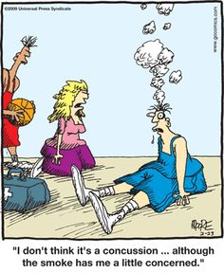
Signs
Loss of Consciousness
Vomiting
Appears Off Balance or Clumsy
Appears slowed down
Personality changes
Sluggish or uneven pupils
Eye movement patterns twitching
Struggles to answer questions
Struggled speech
Does not respond to commands
Notes:
Things you can see

Slide 9

When to go to the hospital?
Vomiting
Loss of Consciousness
Symptoms are worsening over time
  Severity or the number of symptoms

Slide 10
Initial Care – Dont’s
Remove from play!
  No physical activity until cleared
No Screen Time!
  No electronics with screens
No Cocooning!
  Don’t put them in a dark room and force them to sleep for hours.
No Headache Medication
  Medications may dull the symptoms and cause a misdiagnosis.
  NSAIDs and other pain relieving medications can prolong healing.
Notes:
Sports, PE, going to the gym, running on their own, mowing the lawn, etc.
Cell phones, TV, computers, or video games
Can prolong the recovery process.
Try to get through a normal routine.

Slide 11
Initial Care – Do’s
Keep track of the Signs and Symptoms.
Let them eat!
  Increasing the calories during healing can help recovery.
  Regular doses of Vitamins B, D, E and Fish Oil shown to help.
Make sure they are drinking water.
  Dehydration can cause complications
Let them sleep.
  You don’t need to wake them up in the middle of the night to check on them unless instructed to by a doctor.

Slide 12

Diagnosis
ATC determines Possible Concussion
  48 hour rule
No symptoms → ?
Still Symptomatic → Go to your PCP
No concussion → ?
Concussion → Follow the School’s Return to Play Protocol

Slide 13

Return to Learn
Academic restrictions only if requested by the doctor.
RTL monitored regularly by the student’s counselor.
Counselors make updates on a case by case basis.
Once the student completes a full day of school
(no PE) without restrictions and experiences no symptoms for 24 hours without the use of medication they may move on to the RTP protocol.
Notes:
Academic restrictions may mean:
No computer work
Limited reading
Quiet breaks as needed
No quiz or testing
Extra time on assignments
Removal from loud or busy environments (band, crowded hallways)
Half days or no school.
Restrictions may be lessened at the counselor’s discretion.

Slide 14

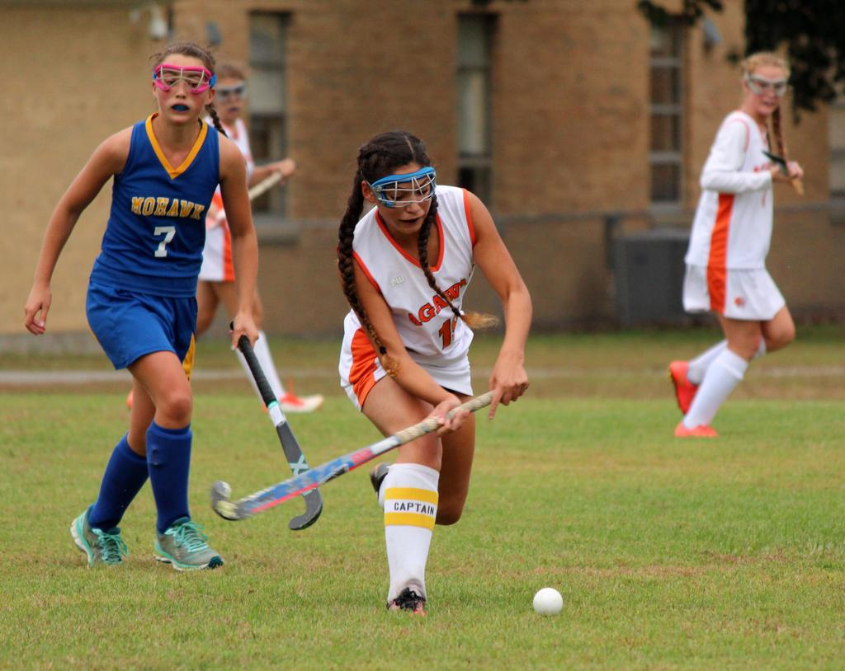
Return to Play
Doctor’s Note: clearing RTP
Day 1 – Light Aerobic Activity
  Stationary Bike 15-20 min
Day 2 – Sport Specific Exercise
  Jogging only drills for 15-20 min
Day 3 – Non-Contact Training
  No-contact practice with sport specific drills, sprinting, and resistance training
Day 4 – Contact Practice
  Full practice
Day 5 – Return to Competition
  Games, game scenarios, or full practice

Slide 15
ImPact Testing
All athletes must take a baseline ImPact test before the season.
Links are on the website and info in the physical packet.
It’s good for 2 years after they take it.
After a concussion – take it again with the ATC.
  DO NOT have them take this at home.
  Helps show how the brain is effected.

Slide 16
More Info
On the school website under the athletics tab is a Concussion section.
Videos and links to more info.
School Policy
ImPact test link

Slide 17
ELIGIBILITY
State Rules:
  Passed at least 30 Credits from previous year- FALL & Winter
  Passed at least 15 credits from first semester-SPRING SEASON
  Have a CURRENT physical on file
  ImPact Test – Done every two years (9th and 11th grade)
  All other forms located in Genesis/Parent Access
  Transfer Forms: If an athlete has transferred from another school (district), a transfer form needs to be completed.
District Rules:
  Fines: Owe no money
  Discipline: Must be under 100 points otherwise they are on Principal’s Probation.

Slide 18
ELIGIBILITY – (cont.)
GENESIS: http://parents.bhprsd.org/genesis
Log into your Parent Access account.
  Required Forms parents must sign off that they have read:
    Concussion
    Sudden Cardiac Death
    Steroids
    Sports Related Eye Injury
    Opioid Use and Misuse Fact Sheet
    Student/Parent handbook: Located in Genesis/Parent Access and on the athletics page of the school’s website
    Powerpoint
    ****MUST BE DONE EVERY SPORT SEASON

Slide 19
PROCEDURES
Travel to and from events:
  All athletes are required to ride the bus
  Travel Release:
    Must be an Emergency and request must be made 24 hours in advance
    Email me (ftorcasio@bhprsd.org)
Chain of Command:
  If you or your child has an issue:
    Athlete Talk to Coach
    Parent Talk to Coach
    Contact Athletic Office

Slide 20
PROCEDURES (cont.)
Parent Communication and 24 Hour Rule:
  Please allow 24 hours after a contest or practice to contact the coach.
Sportsmanship:
  Players Play, Coaches Coach, Officials Officiate……Parents watch and have fun!
    www.nfhslearn.com
        Sportsmanship
        Positive Sport Parenting
Returning Uniforms-
All uniforms must be turned in to the coach after last contest of the season. Failure to do so will result in award not being issued.

Slide 21
Follow Timber Creek Athletics on Twitter at @TCreekSports
THANK YOU!!

